Slide 1
A Patient-Aware Evaluation of Machine Learning and Deep Tabular Models for Parkinson's Disease Voice Screening
Addressing Data Leakage and Validating Acoustic Biomarkers
Arunavo Das, Md. Talha Jobair, Md Abir Ahmed, and Mustafizur Ankan
Department of CSE, East West University

Slide 2
The Clinical Challenge of Parkinson's
•
The Disease: Parkinson's Disease (PD) is a progressive neurodegenerative disorder affecting millions globally, where early and accurate diagnosis is critical for intervention and symptom management.
•
Traditional Limitations: Standard clinical exams, often utilizing the Unified Parkinson's Disease Rating Scale (UPDRS), are expensive, highly subjective, and heavily dependent on a specialized neurologist's physical presence.
•
Our Alternative Approach: Vocal impairment (specifically hypokinetic dysarthria—encompassing reduced volume, monoloudness, and breathiness) is an early, pervasive, and highly measurable symptom. We utilize digital voice recordings for objective, non-invasive, remote screening.

Slide 3






Dataset Overview (Sakar et al.)
We utilized the comprehensive acoustic dataset introduced by Sakar et al., ensuring rigorous evaluation across a diverse patient cohort.
756
252
3
Total Voice Recordings
Distinct Patients
Recordings Per Patient
754
Dense Acoustic Features

Slide 4

The "Data Leakage" Problem in Existing Literature
•
The Issue: Many existing machine learning papers report classification accuracies exceeding 85%, and sometimes 95%, on this specific dataset.
•
The Methodological Flaw: These studies frequently utilize standard K-Fold cross-validation across the 756 total recordings without grouping by patient.
•
The Leakage Event: Standard K-Fold randomly splits the pool of recordings. It almost certainly places "Recording 1" of a patient in the training set and "Recording 2" of the exact same patient in the test set.
The Consequence: The model inadvertently memorizes patient vocal identity (e.g., "John Doe's specific voice baseline") rather than generalizing to true pathological markers of Parkinson's. This leads to artificially inflated metrics that fail in the real world.

Slide 5






Our Rigorous Validation Methodology
Patient-Grouped Validation
The Constraint
Class Imbalance & SMOTE
We implemented a strict GroupKFold(n_splits=5) strategy to enforce real-world separation between training and evaluation cohorts.
The absolute grouping variable is the unique Patient ID. All 3 recordings of a single patient must remain in the same fold (either all in train, or all in test).
We applied SMOTE oversampling strictly within the training folds to prevent data snooping, simulating predictions on completely unseen patients.

Slide 6


Model Architectures Evaluated
Gradient Boosting Decision Trees (GBDTs)
Deep Tabular Learning
Evaluating state-of-the-art tree ensembles:
Contrasting trees with modern neural architectures:
•
XGBoost: eXtreme Gradient Boosting with rigorous objective regularization to prevent high-dimensional overfitting.
•
Custom PyTorch Architecture: Designed specifically for tabular medical data.
•
LightGBM: Employs histogram-based binning and leaf-wise growth for extremely fast convergence.
•
Inspiration: Based heavily on the recent FT-Transformer framework.
•
Mechanics: Utilizes independent Feature Tokenization mapping scalars to dense vectors, followed by Multi-Head Self-Attention (MHSA).
•
CatBoost: Utilizes ordered boosting permutations to systematically reduce prediction shift and target leakage.

Slide 7

Quantifying the Data Leakage Inflation
Cross-Validation Strategy | Accuracy | ROC-AUC
Strict GroupKFold (No Leakage) | 0.7752 | 0.7802
Naive KFold (Leaked) | 0.8400 | 0.8808
Measured Inflation (Overestimation) | + 6.48 pts | + 10.06 pts
Conclusion: Failing to group by patient artificially inflates accuracy metrics by over 6.4 percentage points, and AUC by over 10 points, completely invalidating real-world clinical deployment claims. Un-grouped models memorize identity, not pathology.

Slide 8

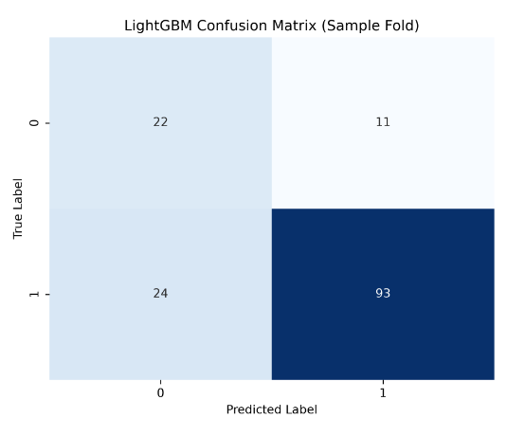
Model Benchmarks & Diagnostic Behavior
•
Optimal Balance: LightGBM and XGBoost achieved the optimal balance navigating the high-dimensional feature space effectively.
•
Clinical Viability: The matrix explicitly highlights the model's high recall for the PD class. Minimizing false negatives (missing a diseased patient) is critical in medical screening.
•
Deep Learning Context: The PyTorch FT-Transformer underperformed in overall accuracy compared to boosting models. Deep tabular architectures often overfit and struggle to converge without memorization on small medical datasets ($n=252$).

Slide 9

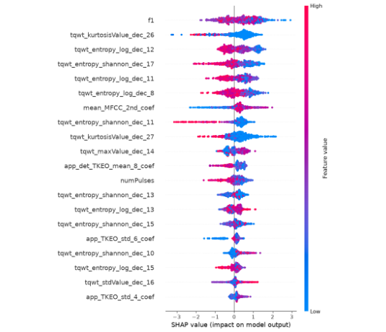
Algorithmic Explainability (SHAP)
•
The Goal: Translate black-box AI decisions into interpretable clinical insights using SHapley Additive exPlanations (SHAP) applied to tree outputs.
•
Key Finding: Classical features like fundamental frequency ('f1') and specific Mel-Frequency Cepstral Coefficients (MFCCs) consistently drive the model's robust diagnosis across all algorithms.
•
Physiological Meaning: The model relies heavily on the broad vocal tract envelope. High-energy micro-tremors in specific frequency bands push the model's logits strongly toward a positive PD diagnosis.
•
Consensus: We observed a striking Top-10 feature overlap (8/10) across XGBoost, LightGBM, and CatBoost.

Slide 10
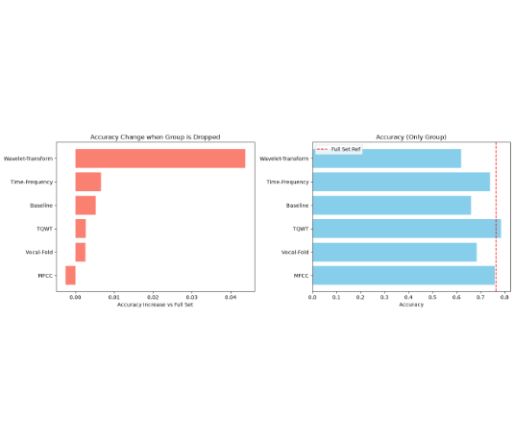

Curse of Dimensionality: Feature Group Ablation
•
Experiment Design: We aggregated the 754 features into domains (MFCC, TQWT, Baseline, Wavelet-Transform) and systematically removed them (Leave-One-Group-Out) to measure independent predictive power.
•
Catastrophic Drops vs Gains: Removing MFCCs was the only action that caused a degradation in accuracy. Conversely, removing Wavelet-Transforms actually increased accuracy by over 4%.
Conclusion: Removing almost any feature group improves performance due to heavy collinearity. Classical speech processing (MFCCs) remains the most robust biomarker; complex Wavelet transforms introduce significant noise on this dataset.

Slide 11





Clinical Edge-Deployment & Conclusion
Edge-Computing Viability
Final Takeaways
Future Work
XGBoost inference latency is < 0.02 milliseconds per sample with a microscopic 147 KB memory footprint. It is 100% viable for offline, resource-constrained smartphone screening applications.
•
Patient grouping is mandatory.
Transitioning from binary diagnosis to predicting exact UPDRS severity stages to track disease progression longitudinally, and performing massive Bayesian hyperparameter tuning.
Regularized GBDTs remain superior to Deep Tabular models for small datasets.
•
Classical MFCCs remain robust; highly dense Wavelets act as noise.
•

Slide 12
APPENDIX
Supplementary Technical Details, Algorithms, and Comprehensive Benchmarks

Slide 13




Appendix: Mathematical Foundations (Acoustics)
Jitter (Absolute) - Cycle-to-Cycle Instability
Mel-Frequency Cepstral Coefficients (MFCC)
Measures fundamental frequency micro-variations:
Perceptual auditory frequency mapping:

Slide 14
Appendix: Fold-Level Preprocessing (Algorithm 1)
for each fold (train_idx, test_idx) in GroupKFold do
X_train, X_test ← X[train_idx], X[test_idx]
y_train, y_test ← y[train_idx], y[test_idx]
// 1. Remove zero-variance (constant) features
vt ← VarianceThreshold(0.01)
X_train ← vt.fit_transform(X_train)
X_test ← vt.transform(X_test)
// 2. Standardize features to zero mean, unit variance
scaler ← StandardScaler()
X_train ← scaler.fit_transform(X_train)
X_test ← scaler.transform(X_test)
// 3. Select top 50 features via ANOVA F-value (SelectKBest)
skb ← SelectKBest(f_classif, k = 50)
X_train ← skb.fit_transform(X_train, y_train)
X_test ← skb.transform(X_test)
// 4. Apply SMOTE imbalance handling strictly on training fold
smote ← SMOTE(random_state = 42)
X_train_resampled, y_train_resampled ← smote.fit_resample(X_train, y_train)
// 5. Fit Model and Evaluate
model.fit(X_train_resampled, y_train_resampled)
evaluate(model, X_test, y_test)
end for

Slide 15
Appendix: Gradient Boosting Results (Mean ± Std)
All models evaluated using the strict GroupKFold cross-validation strategy, avoiding data leakage.
Model | Accuracy | Precision | Recall | ROC-AUC
XGBoost | 0.7752 ± 0.0396 | 0.8358 ± 0.0387 | 0.8731 ± 0.0444 | 0.7802 ± 0.0588
LightGBM | 0.7632 ± 0.0492 | 0.8292 ± 0.0375 | 0.8624 ± 0.0499 | 0.7646 ± 0.0794
CatBoost | 0.7739 ± 0.0413 | 0.8424 ± 0.0395 | 0.8606 ± 0.0490 | 0.7964 ± 0.0749

Slide 16

Appendix: Deep Tabular Model Results (FT-Transformer)
Metric | Score (Mean ± Std)
Accuracy | 0.7409 ± 0.0496
Precision | 0.8563 ± 0.0530
Recall | 0.7880 ± 0.0400
F1 Score | 0.8194 ± 0.0341
ROC-AUC | 0.7790 ± 0.0727
Performance Context
While achieving highly robust precision, overall grouped accuracy lags slightly behind the state-of-the-art boosting models.
This is a common observation on smaller tabular datasets (n < 1000) where Transformer-based architectures tend to overfit the training distribution despite heavy regularization techniques like weight decay and dropout.

Slide 17

Appendix: Model Complexity and Deployment Efficiency
XGBoost and LightGBM present an optimal, Pareto-efficient balance of training speed, inference latency, and minimal footprint for edge deployment on smartphones.
Model | Train Time (s) | Inf Latency (ms) | Size (KB) | Complexity
XGBoost | 0.47 | 0.01 | 147.21 | 100 estimators
LightGBM | 0.35 | 0.02 | 343.87 | 100 estimators
CatBoost | 14.48 | 0.01 | 1108.12 | 1000 estimators
Deep Tabular | 63.64 | 0.16 | 121.89 | 20,417 params

Slide 18
Questions?
Thank you for your attention.

